Slide 1
Causal Inference Crash Course: Foundations
Julian Hsu

Slide 2
Causal Inference Series
Foundations
Defining Some ATE/ATET Causal Models
ATE/ATET Inference, Asymptotic Theory, and Bootstrapping
Best Practices: Outliers, Class Imbalance, Feature Selection, and Bad Control
Heterogeneous Treatment Effect Models and Inference
Difference-in-Difference Models for Panel Data
Regression Discontinuity Models
Arguable Validation

Slide 3
Overview
This is intended to be the first in a series of causal inference
This presentation will cover:
The fundamental problem of causal inference
Necessary assumptions for valid causal inference
Working example with simulated data
The intended audience is a scientist familiar with basic statistics and unfamiliar with causal inference

Slide 4
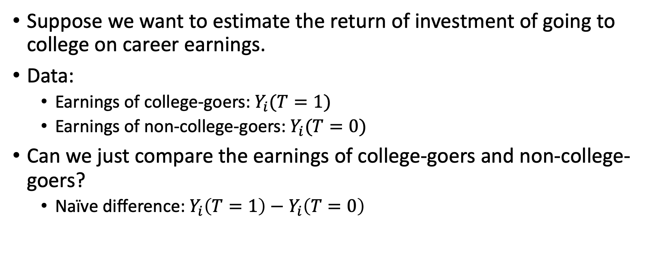
Fundamental problem of causal inference
Suppose we want to estimate the return of investment of going to college on career earnings.
Data:
Earnings of college-goers: $Y_{i}(T=1)$
Earnings of non-college-goers: $Y_{i}(T=0)$
Can we just compare the earnings of college-goers and non-college-goers?
Naïve difference: $Y_{i}\left(T=1\right)−Y_{i}\left(T=0\right)$

Slide 5
Do we know what happens in the counterfactual situation?
We cannot, because college-goers tend to be different from non-college-goers.
In other words, we do not think that the observed earnings of non-college-goers accurately represents the earnings of college-goers if they did not go to college, and vice versa.
In other words, correlation is not causation.
We formalize this with the “potential outcomes” mental model (aka Neyman-Rubin causal model).

Slide 6

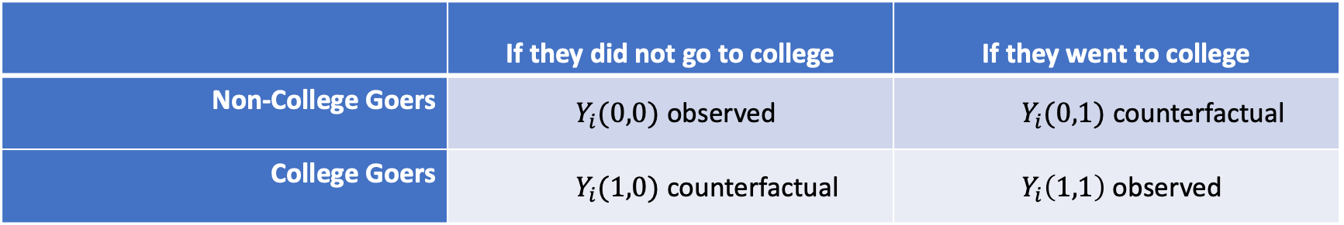
Potential outcomes framework
There is a difference between what we observe, and what we wish we could observe.
We only observe $Y_{i}(0,0)$ and $Y_{i}\left(1,1\right)$ but we want to observe the counterfactuals.
If we think that $Y_{i}\left(1,1\right) − Y_{i}\left(0,0\right)$ is the real effect of going to college, then we are also assuming that $Y_{i}\left(1,1\right)=Y_{i}\left(0,1\right),$ and $Y_{i}\left(0,0\right)=Y_{i}\left(1,0\right)$.
 | If they did not go to college | If they went to college
Non-College Goers | $Y_{i}(0,0)$ observed | $Y_{i}(0,1)$ counterfactual
College Goers | $Y_{i}(1,0)$ counterfactual | $Y_{i}\left(1,1\right)$ observed
Notes:
Can we assume that the earnings of college goers is the earnings of non-college goers, had they attended college?

Slide 7
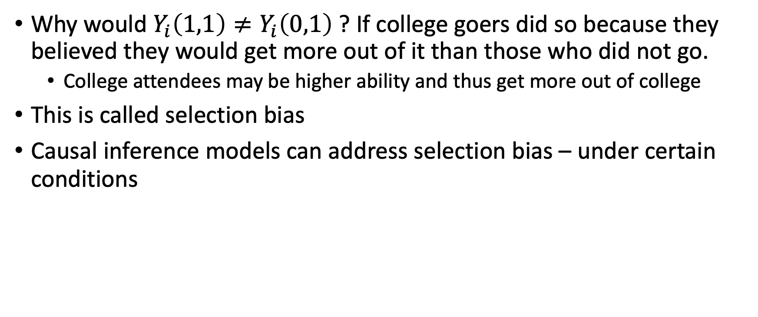
Selection bias
Why would $Y_{i}\left(1,1\right)≠Y_{i}\left(0,1\right)$ ? If college goers did so because they believed they would get more out of it than those who did not go.
College attendees may be higher ability and thus get more out of college
This is called selection bias
Causal inference models can address selection bias – under certain conditions

Slide 8
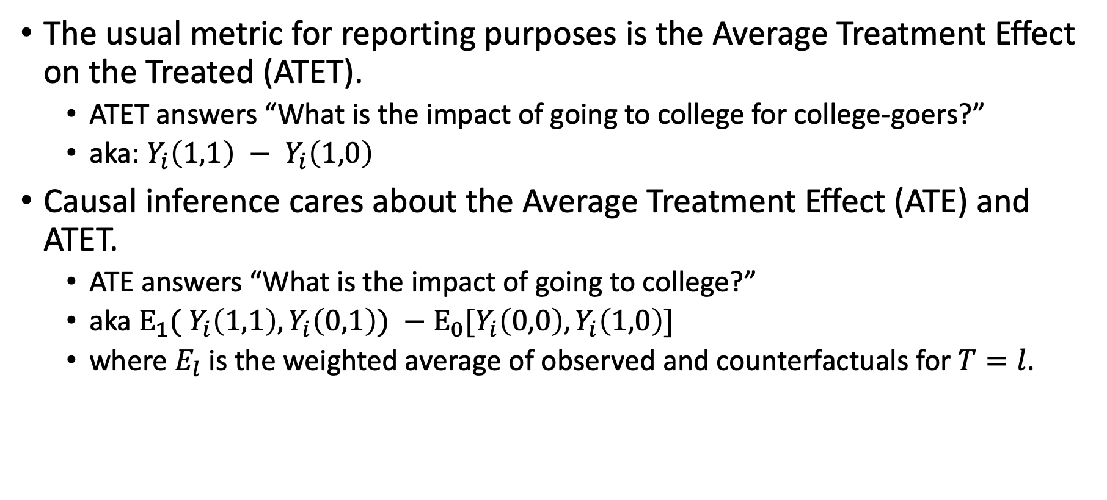
Causal inference and reporting
The usual metric for reporting purposes is the Average Treatment Effect on the Treated (ATET).
ATET answers “What is the impact of going to college for college-goers?”
aka: $Y_{i}\left(1,1\right) − Y_{i}\left(1,0\right)$
Causal inference cares about the Average Treatment Effect (ATE) and ATET.
ATE answers “What is the impact of going to college?”
aka $E_{1}( Y_{i}\left(1,1\right), Y_{i}\left(0,1\right)) −E_{0}[Y_{i}\left(0,0\right), Y_{i}\left(1,0\right)]$
where $E_{l}$ is the weighted average of observed and counterfactuals for $T=l$.

Slide 9
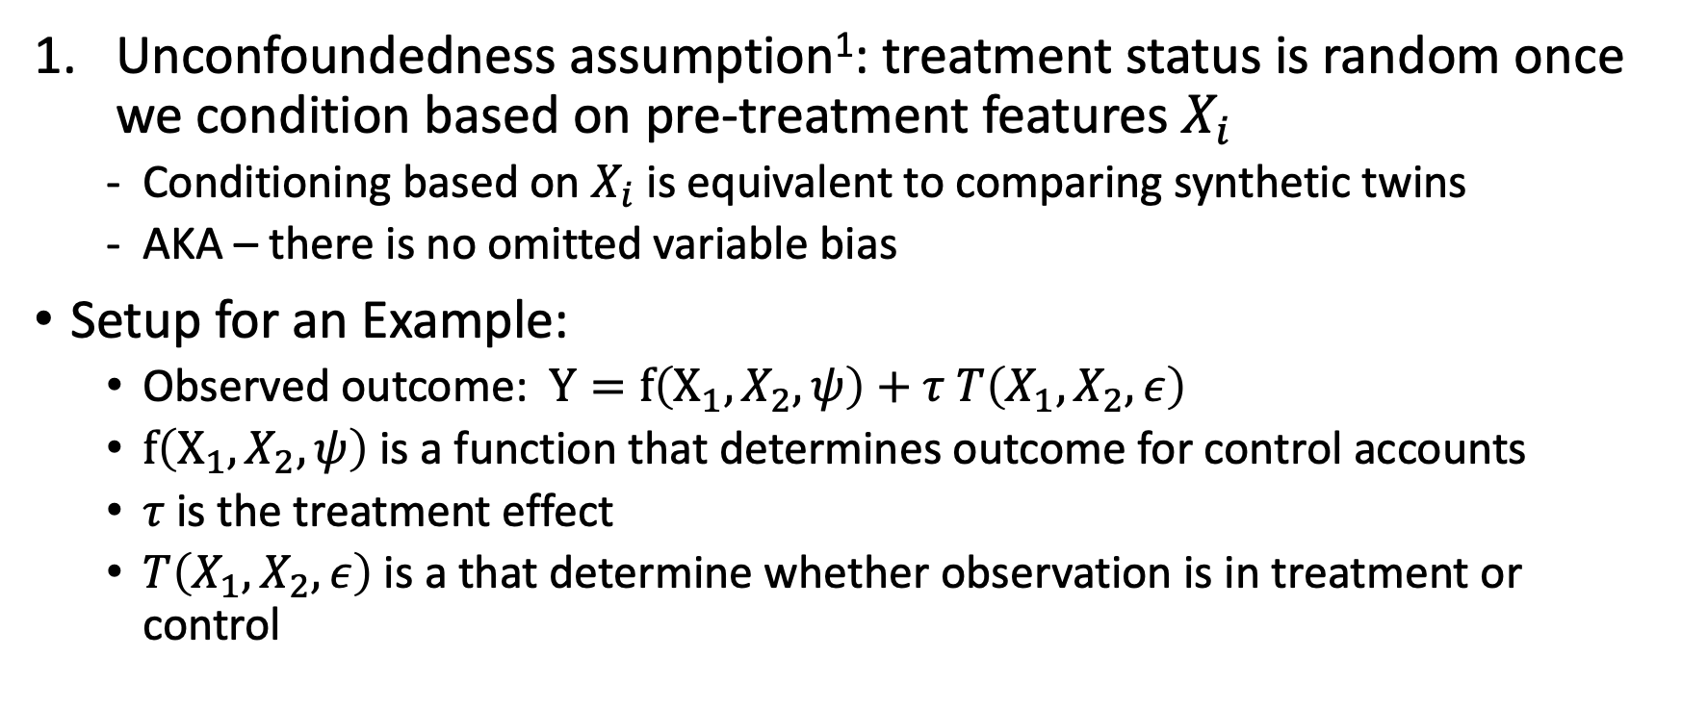
Three necessary assumptions for valid causal inference
Unconfoundedness assumption¹: treatment status is random once we condition based on pre-treatment features $X_{i}$
Conditioning based on $X_{i}$is equivalent to comparing synthetic twins
AKA – there is no omitted variable bias
Setup for an Example:
Observed outcome: $Y=f\left(X_{1},X_{2},ψ\right)+τ T\left(X_{1},X_{2},ε\right)$
$f\left(X_{1},X_{2},ψ\right)$ is a function that determines outcome for control accounts
$τ$is the treatment effect
$T\left(X_{1},X_{2},ε\right)$ is a that determine whether observation is in treatment or control
¹ aka selection-on-observables, conditional independence, ignorability, conditional independence assumptions.
Notes:
Note that for estimating ATE, we can rely on mean independence, where the expected value of the outcome conditional on X is the same as the potential outcomes.

Slide 10
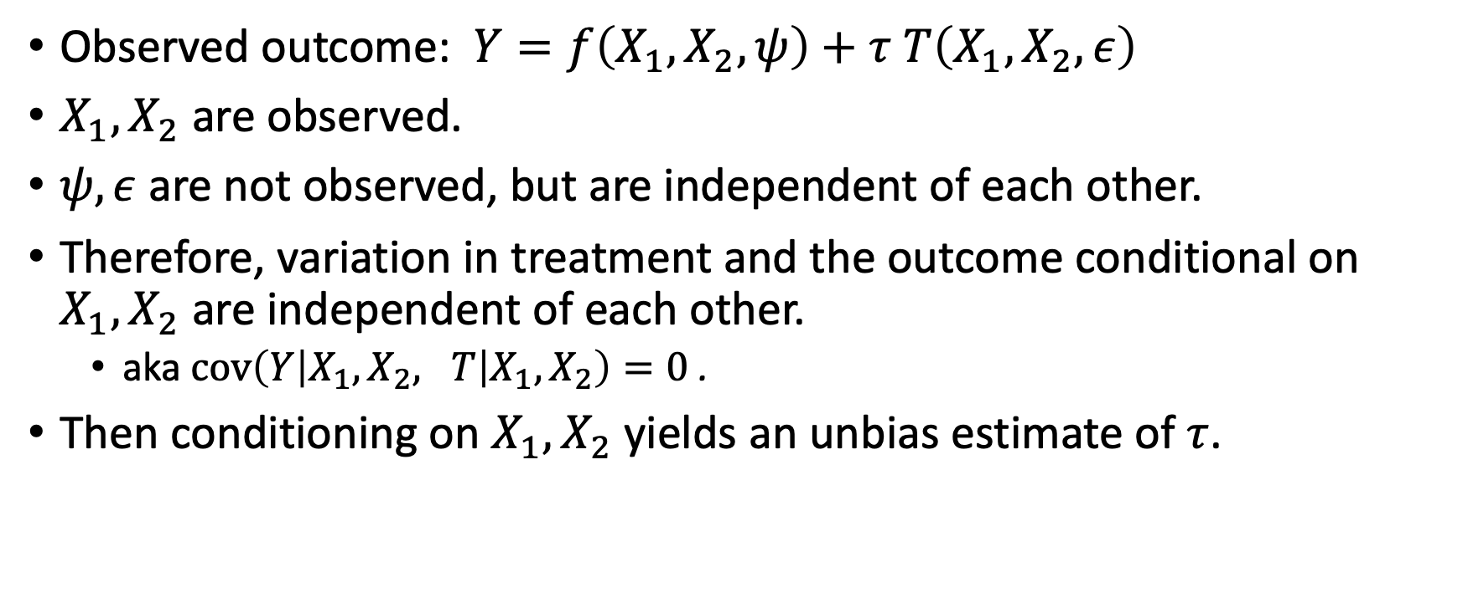
Scenario 1: the ideal
Observed outcome: $Y=f\left(X_{1},X_{2},ψ\right)+τ T\left(X_{1},X_{2},ε\right)$
$X_{1},X_{2}$ are observed.
$ψ, ε$ are not observed, but are independent of each other.
Therefore, variation in treatment and the outcome conditional on $X_{1},X_{2}$ are independent of each other.
aka $cov\left(Y\left|X_{1},X_{2}, T\right|X_{1}, X_{2}\right)=0$ .
Then conditioning on $X_{1},X_{2}$ yields an unbias estimate of $τ$.

Slide 11
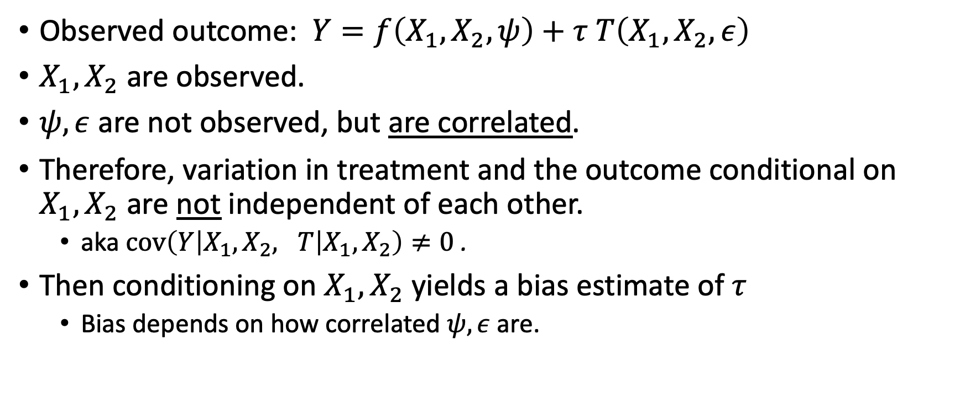
Scenario 2: not ideal
Observed outcome: $Y=f\left(X_{1},X_{2},ψ\right)+τ T\left(X_{1},X_{2},ε\right)$
$X_{1},X_{2}$ are observed.
$ψ, ε$ are not observed, but are correlated.
Therefore, variation in treatment and the outcome conditional on $X_{1},X_{2}$ are not independent of each other.
aka $cov\left(Y\left|X_{1},X_{2}, T\right|X_{1}, X_{2}\right)≠0$ .
Then conditioning on $X_{1},X_{2}$ yields a bias estimate of $τ$
Bias depends on how correlated $ψ, ε$ are.

Slide 12

So what happens in the not ideal scenario?
You will still get an estimate for $τ$, but it will be biased.
Recall this $ψ, ε$ are not observed, but are correlated with each other.
You cannot identify what portion for $\hat{τ}$ is due to the true treatment effect $τ$, and what is due to$ψ$or $ε.$

Slide 13
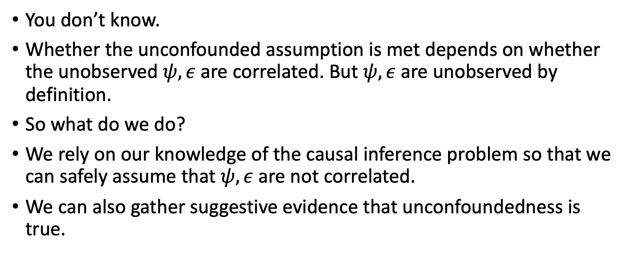
How do we know if we are in the ideal or not ideal scenario?
You don’t know.
Whether the unconfounded assumption is met depends on whether the unobserved $ψ, ε$ are correlated. But $ψ, ε$ are unobserved by definition.
So what do we do?
We rely on our knowledge of the causal inference problem so that we can safely assume that $ψ, ε$ are not correlated.
We can also gather suggestive evidence that unconfoundedness is true.

Slide 14
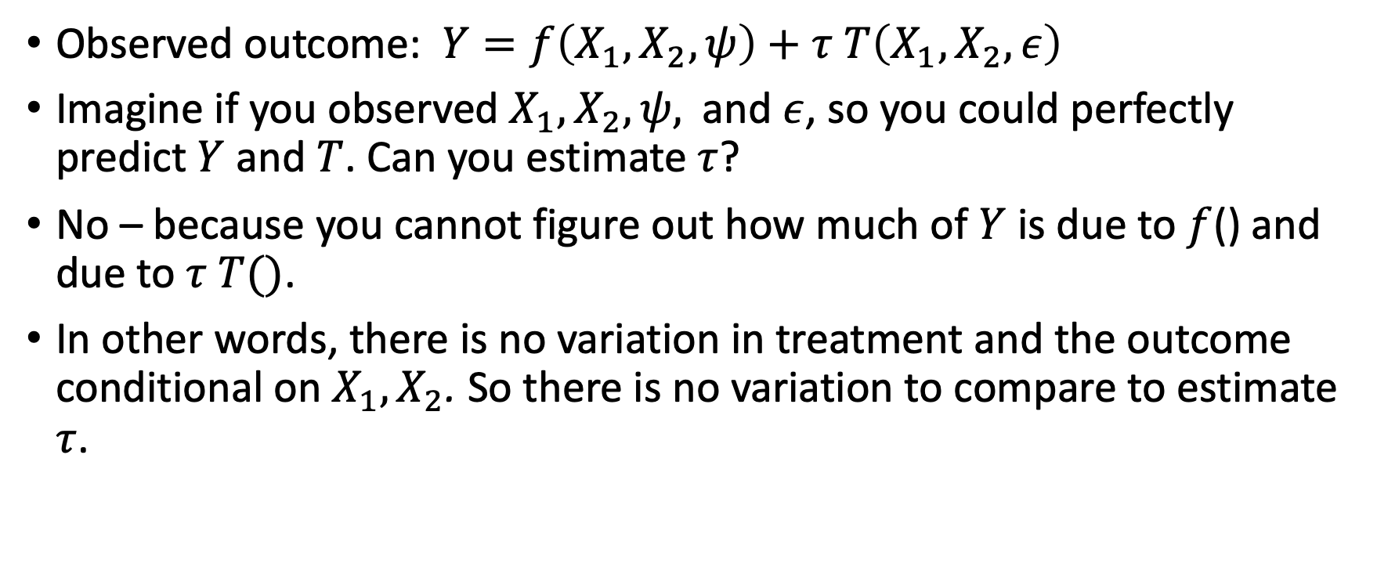
Valid causal inference relies on having the “perfect” but “imperfect” prediction problem
Observed outcome: $Y=f\left(X_{1},X_{2},ψ\right)+τ T\left(X_{1},X_{2},ε\right)$
Imagine if you observed $X_{1},X_{2},ψ,$and $ε$, so you could perfectly predict $Y$ and $T$. Can you estimate $τ$?
No – because you cannot figure out how much of $Y$ is due to $f$() and due to $τ T()$.
In other words, there is no variation in treatment and the outcome conditional on $X_{1},X_{2}$. So there is no variation to compare to estimate $τ$.

Slide 15
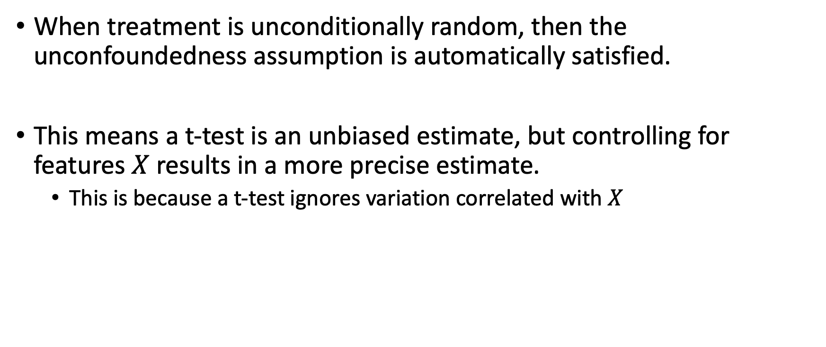
Randomized control trials / Experiments / AB tests
When treatment is unconditionally random, then the unconfoundedness assumption is automatically satisfied.
This means a t-test is an unbiased estimate, but controlling for features $X$results in a more precise estimate.
This is because a t-test ignores variation correlated with $X$
Notes:
More technical explanation is that the t-test can be reformulated as a single moment estimator, but controlling for features introduces more moment conditions. This results in better identification and estimator efficiency.

Slide 16
Three necessary assumptions for valid causal inference - SUTVA
Stable unit treatment value assumption: control units do not influence treatment units.
A violation of this would be college-goers help non-college-goers get higher paying jobs
We can only test this if we observe how treatment and control observations are connected. (Network data)
In practice, this is usually assumed away because of how difficult it is to get network data.

Slide 17
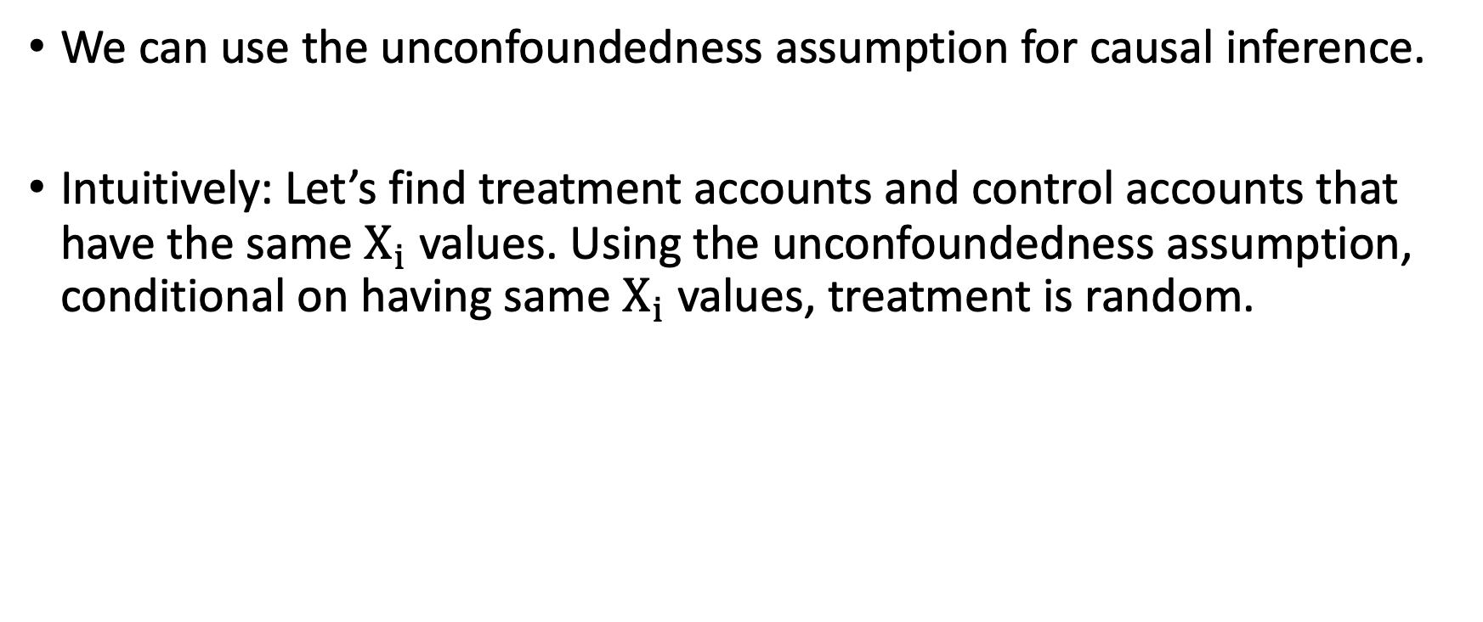
Estimating treatment effects using matching
We can use the unconfoundedness assumption for causal inference.
Intuitively: Let’s find treatment accounts and control accounts that have the same $X_{i}$ values. Using the unconfoundedness assumption, conditional on having same $X_{i}$ values, treatment is random.
Notes:
What is the difference between conditional on X
You need treatment labels

Slide 18
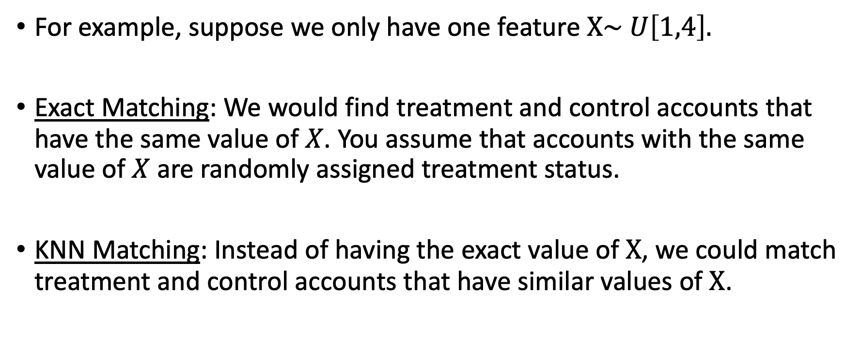
Exact and KNN Matching Examples
For example, suppose we only have one feature $X\sim U\left[1,4\right].$
Exact Matching: We would find treatment and control accounts that have the same value of $X$. You assume that accounts with the same value of $X$are randomly assigned treatment status.
KNN Matching: Instead of having the exact value of $X$, we could match treatment and control accounts that have similar values of $X$.
Notes:
Average Treatment Effect = $E_{x}[Y_{T=1}\left(X=x\right)]−E_{x}[Y_{T=0}\left(X=x\right)]$

Slide 19
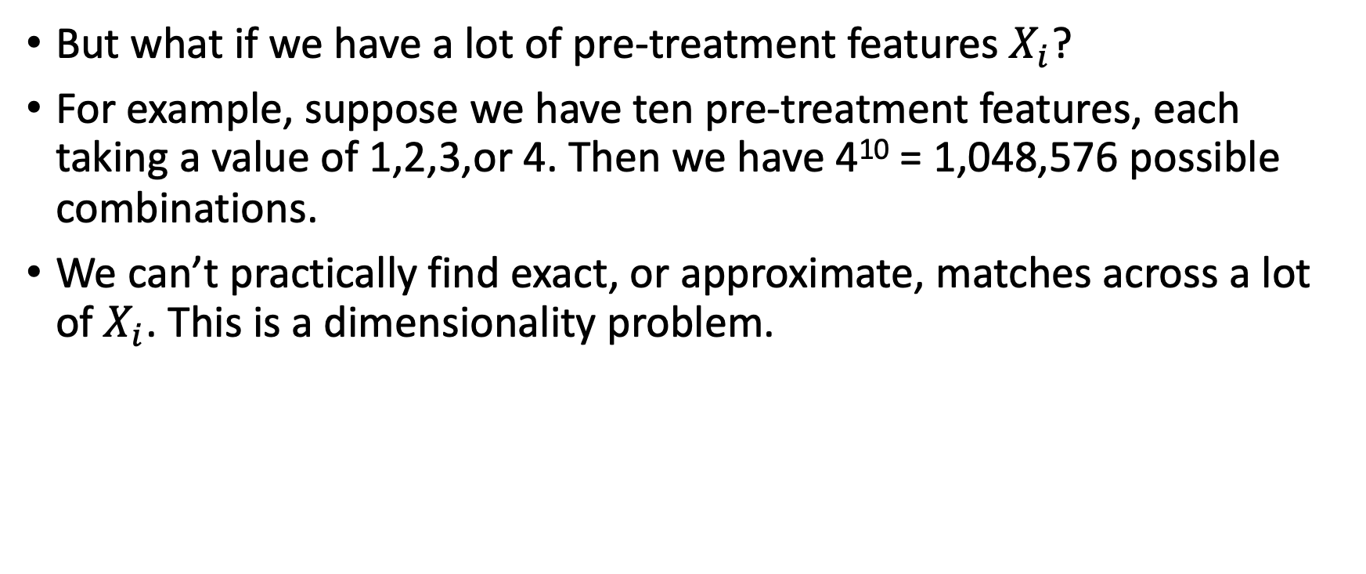
Matching leads to the curse of dimensionality
But what if we have a lot of pre-treatment features $X_{i}$?
For example, suppose we have ten pre-treatment features, each taking a value of 1,2,3,or 4. Then we have 4¹⁰ = 1,048,576 possible combinations.
We can’t practically find exact, or approximate, matches across a lot of $X_{i}$. This is a dimensionality problem.
* Rosenbaum, P. and Rubin, D. 1983. “The central role of the propensity score in observational studies for causal effects.” Biometrika. Vol 70-1.

Slide 20
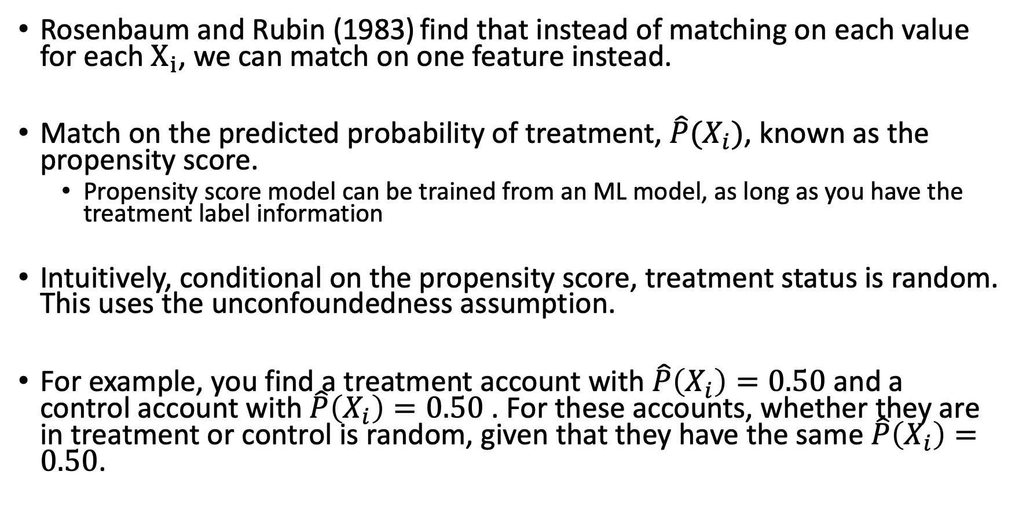
Propensity Score Matching
Rosenbaum and Rubin (1983) find that instead of matching on each value for each $X_{i}$, we can match on one feature instead.
Match on the predicted probability of treatment, $\hat{P}(X_{i})$, known as the propensity score.
Propensity score model can be trained from an ML model, as long as you have the treatment label information
Intuitively, conditional on the propensity score, treatment status is random. This uses the unconfoundedness assumption.
For example, you find a treatment account with $\hat{P}\left(X_{i}\right)=0.50$ and a control account with $\hat{P}\left(X_{i}\right)=0.50$ . For these accounts, whether they are in treatment or control is random, given that they have the same $\hat{P}\left(X_{i}\right)=0.50$.

Slide 21

Three necessary assumptions for valid causal inference - Overlap
Overlap assumption: we can find control and treatment accounts with similar propensity score $\hat{P}(X_{i})$.
- This one we can verify if we have the true propensity score. We can plot the distribution of propensity scores for treatment and control groups, and see if there is reasonable overlap.

Slide 22
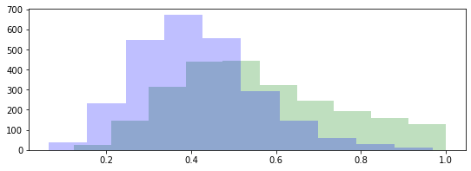
Ideal scenario
Control and treatment accounts overlap in propensity stores, so there are plenty of control and treatment accounts to compare.

Slide 23
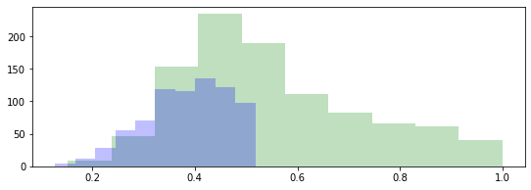
Not ideal scenario
Plenty of control and treatment accounts to compare.
No control accounts with propensity scores here, so no direct comparisons with treatment accounts.
Estimates for these treatment accounts are extrapolations.

Slide 24
Propensity-based models are the most common models
Many causal models are versions of propensity score matching:
Ordinary least squares (OLS)
Propensity Binning with Regression adjustment
Inverse propensity weighting
Double machine learning
They all rely on the same assumptions.

Slide 25
Example with Simulated Data
Jupyter Notebook link: [https://github.com/shoepaladin/causalinference_crashcourse/blob/main/Notebooks/1%20Foundations.ipynb]
To make sure we can tell whether the average treatment effect estimate is correct, we will use fake data.
We will setup our fake data, and show the bias under different causal models and whether the assumptions for causal inference are met.

Slide 26

Setup with fake data
We have four iid features, $x_{1},x_{2},x_{3},$ and $x_{4}$ from normal distributions.
The observed outcome is:
$Y=f\left(x_{1},x_{2},x_{3},x_{4},ψ\right)+τ × T\left(x_{1},x_{2},x_{3},x_{4},ε\right)$
Where $(ψ, ε)$ are independent.

Slide 27
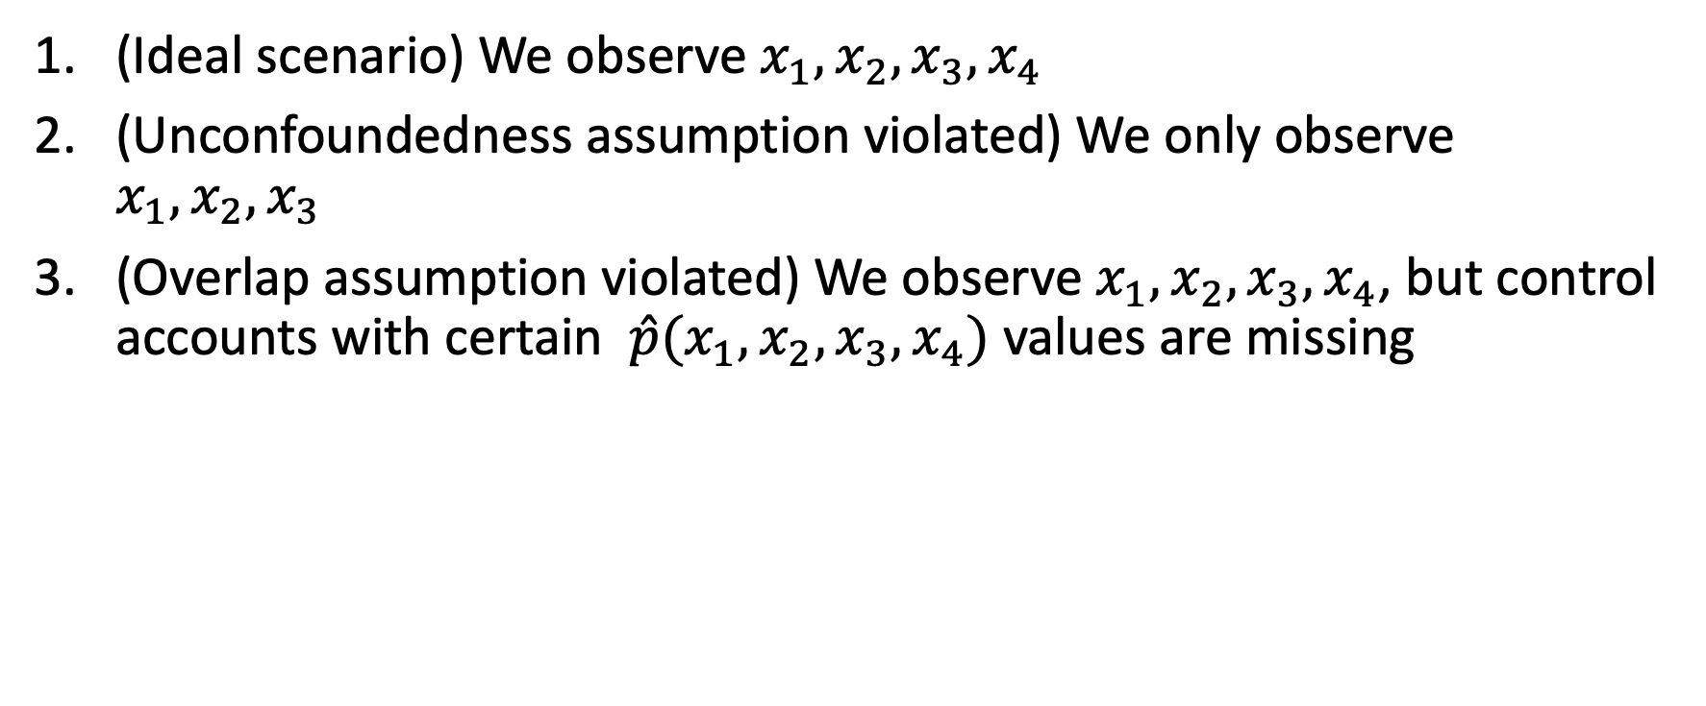
We study three scenarios
(Ideal scenario) We observe $x_{1},x_{2},x_{3},x_{4}$
(Unconfoundedness assumption violated) We only observe $x_{1},x_{2},x_{3}$
(Overlap assumption violated) We observe $x_{1},x_{2},x_{3},x_{4}$, but control accounts with certain $\hat{p}(x_{1},x_{2},x_{3},x_{4})$ values are missing

Slide 28
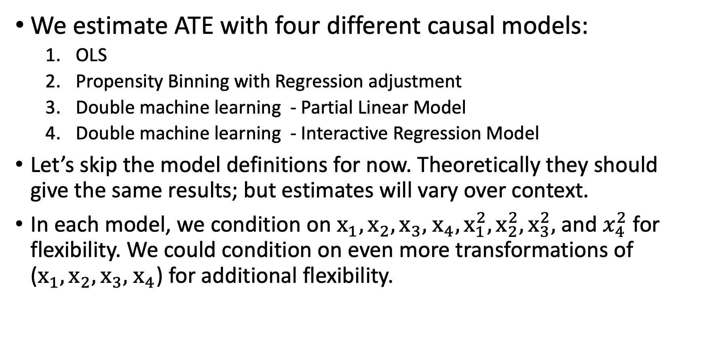
We study four models
We estimate ATE with four different causal models:
OLS
Propensity Binning with Regression adjustment
Double machine learning - Partial Linear Model
Double machine learning - Interactive Regression Model
Let’s skip the model definitions for now. Theoretically they should give the same results; but estimates will vary over context.
In each model, we condition on $x_{1},x_{2},x_{3},$ $x_{4}, x_{1}^{2}, x_{2}^{2},x_{3}^{2},$and $x_{4}^{2}$ for flexibility. We could condition on even more transformations of ($x_{1},x_{2},x_{3},$ $x_{4}$) for additional flexibility.

Slide 29
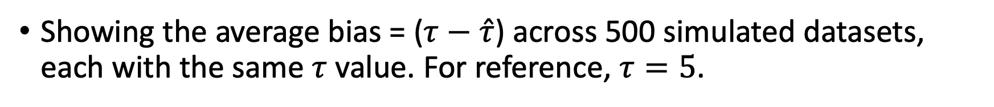
Bias in ATE Estimate across five models and three scenarios
Showing the average bias = ($τ−\hat{τ}$) across 500 simulated datasets, each with the same $τ$ value. For reference, $τ=5$.
 | Ideal Scenario | Unconfoundedness Violated | Overlap Violated
OLS | 0.003 | 0.003 | 0.722
Propensity Binning w/ Regression Adjustment | -0.062 | 0.115 | -1.722
DML – Partial Linear | 0.040 | 0.248 | 0.909
DML – Interactive Regression | 0.036 | 0.292 | 2.186
Notes:
Note these results are not generalizable. This does not mean OLS is the best estimator, because we haven’t used more complicated data generated processes.

Slide 30
Conclusion
This presentation covered some fundamentals for causal inference:
The fundamental causal inference problem
Assumptions for unbiased estimates
Working example
The following slide has a list of future topics. Please let me know what else interests you!

Slide 31
Appendix Slides

Slide 32
Details on Modeling Approaches
The DML-IRM and IPW approaches exclude observations with estimated propensity scores below 0.001 and 0.999 to avoid dividing by a small number, which would inflate estimates.
Except for OLS, all nuisance functions to predict the outcome and treatment status are estimated using four-fold cross-validated LASSO and Logistic regressions.

